Slide 1

E-Commerce Sales Dashboard Report
Analyzing business performance, customer behavior, and operational efficiency through data-driven insights.

Slide 2
EXECUTIVE SUMMARY
Key Performance Indicators
2,400
11,997
$649K
Total Orders
Quantity Sold
Total Revenue
4.0
2.3
Average Rating
Delivery Days
These metrics provide a comprehensive snapshot of business health and customer satisfaction across all channels.

Slide 3

Sales Trends Analysis
Peak Performance
Strong Correlation
Marketing Impact
Sales peaked during weeks 6–10, showing strong seasonal demand patterns.
Revenue and quantity demonstrate positive correlation across all periods.
Campaigns during peak weeks likely influenced growth trajectory.

Slide 4
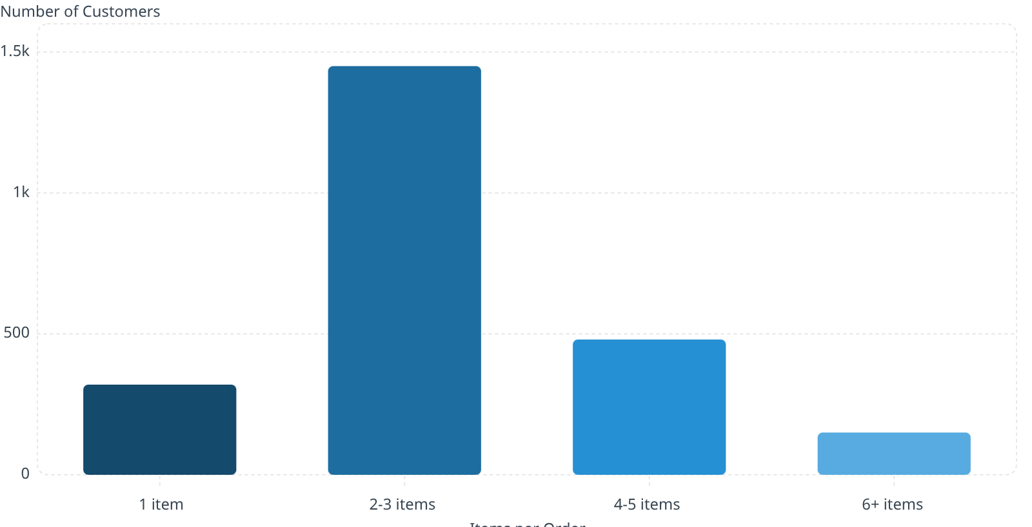
Customer Buying Behavior
2.4k
Key Insight
Total Number of Customers
Most customers purchase 2–3 items per order. Fewer buy 6+ items.
1.45k
Opportunity: Increase Average Order Value through strategic bundle promotions and cross-selling.
480
320
150

Slide 5
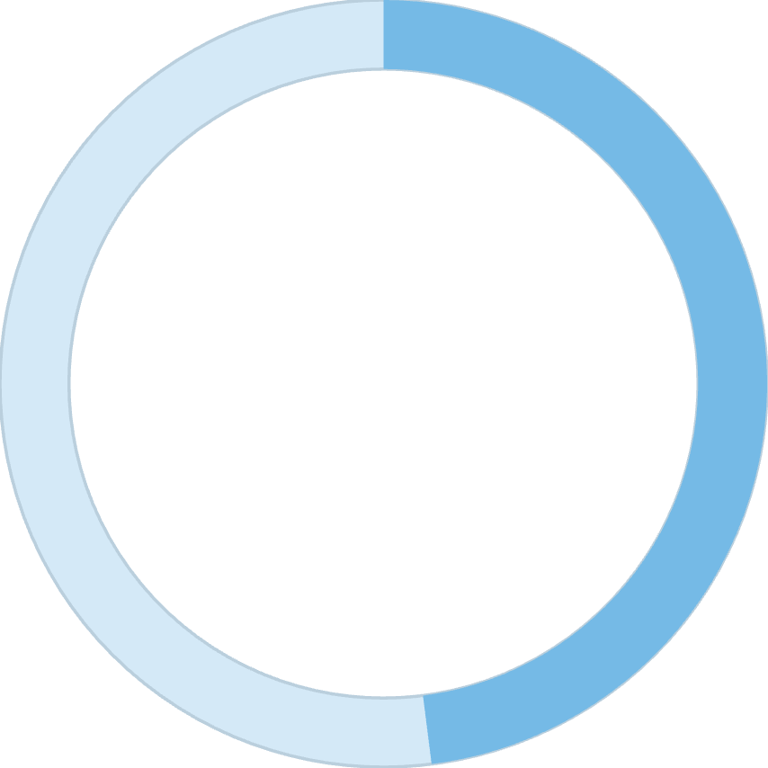
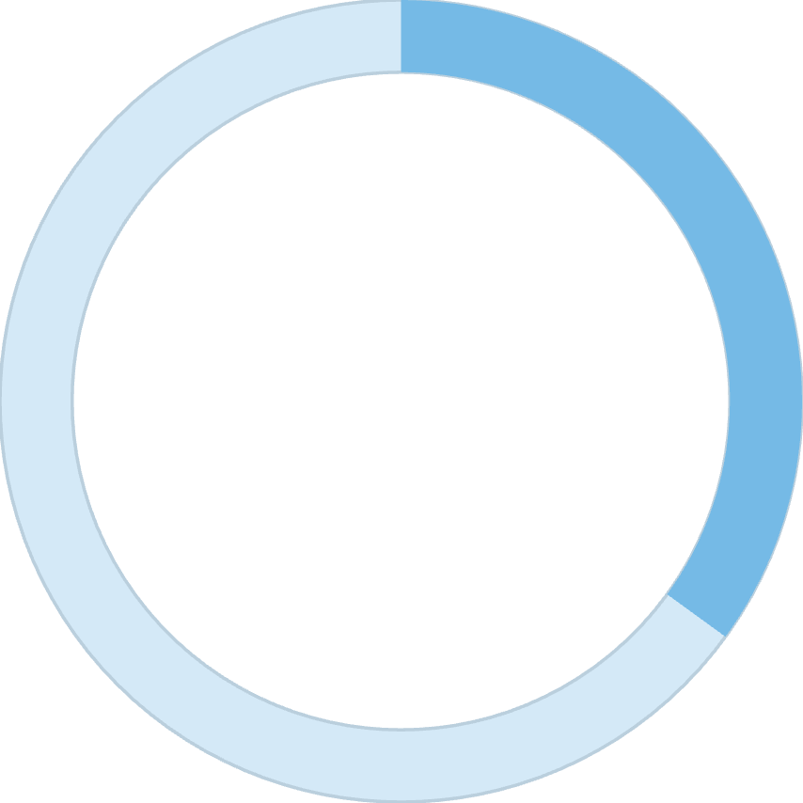
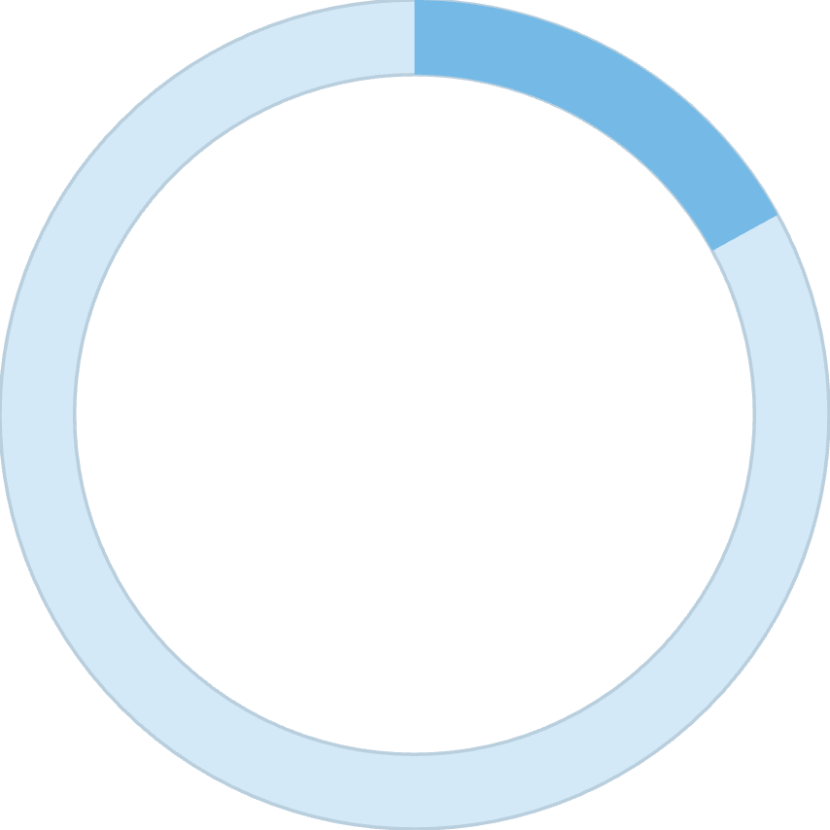
Channel Preference
48%
35%
17%
Mobile App
Website
Target.com
Highest usage channel
Strong desktop presence
Partner platform
Mobile-first strategy proves effective. Continued investment in app experience is justified by user preference.

Slide 6




DEMOGRAPHICS
Product Popularity by Gender
Strategic Opportunity
Female segment drives majority revenue. Targeted campaigns could significantly increase profitability.
Female Customers
Male Customers
Focus on personalized recommendations and gender-specific promotions to maximize conversion rates.
52% of purchases
39% of purchases
Top Products
T-Shirts and Jeans lead sales

Slide 7
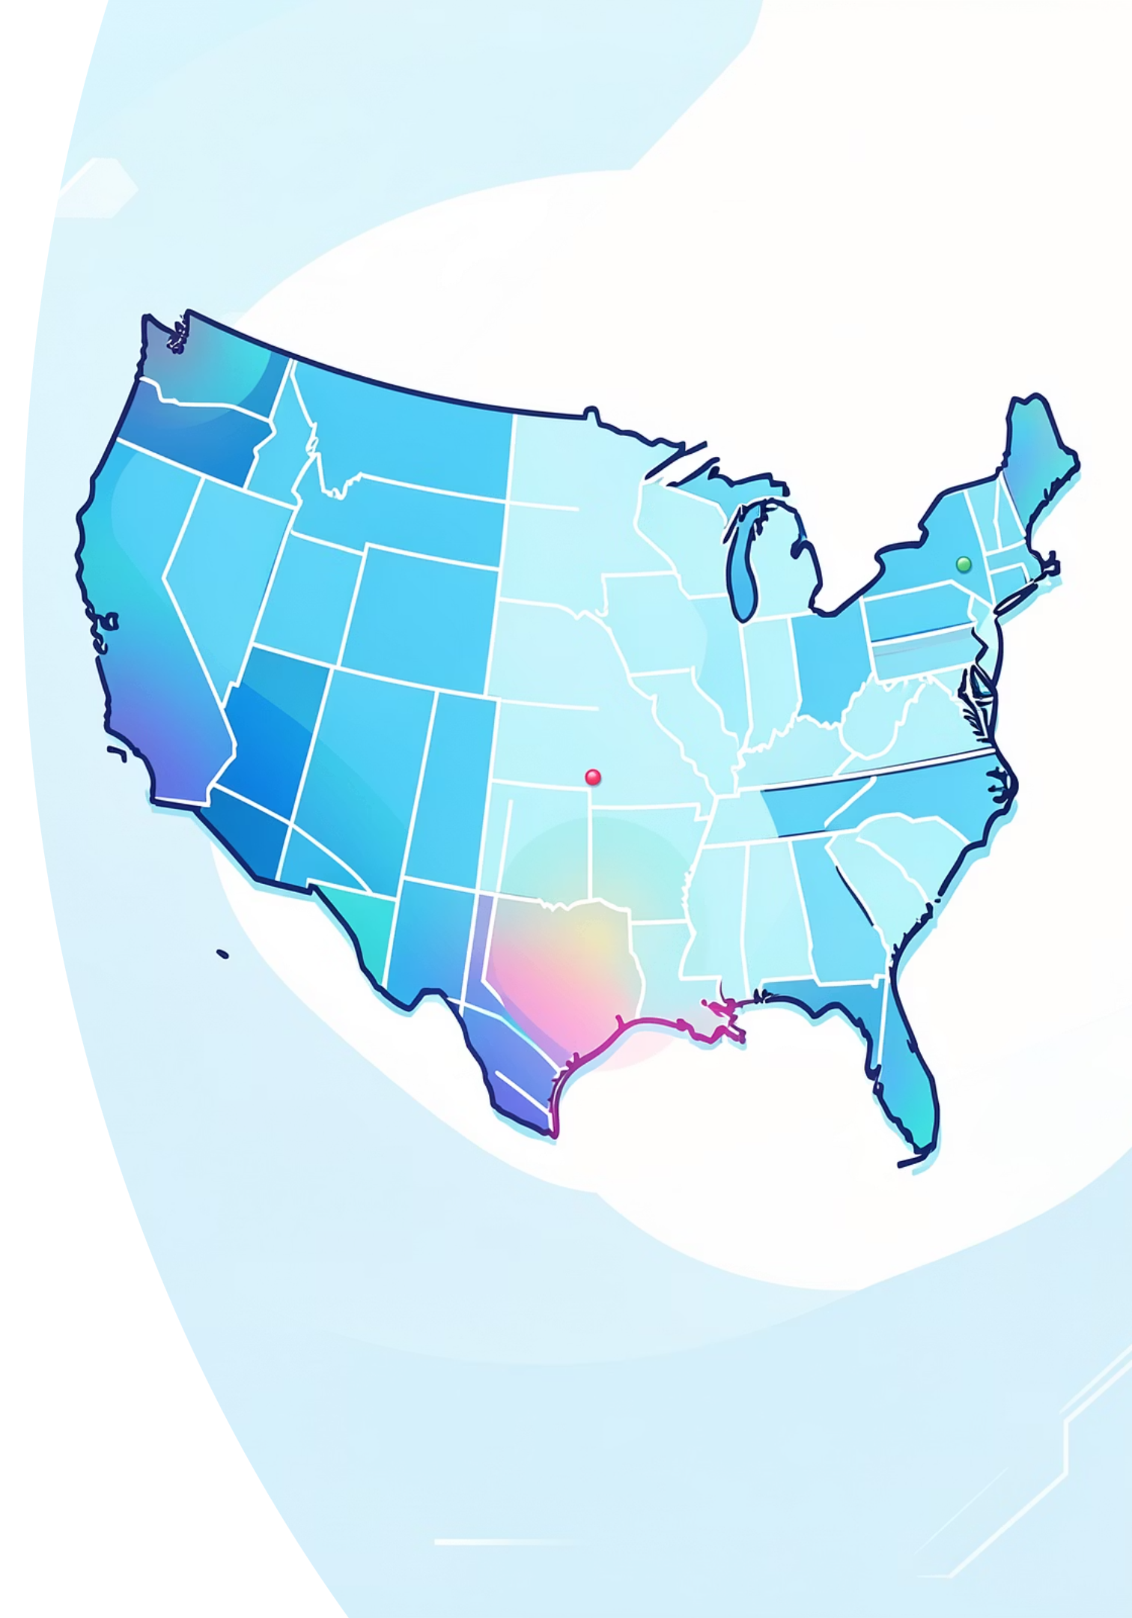
Geographic Distribution
California Dominance
Highest order volume across all states, representing our strongest market presence.
Regional Optimization
Underperforming states present growth opportunities through targeted regional marketing strategies.

Slide 8

Shipping Performance Excellence
Fast & Reliable
Processing
Most orders delivered within 1–3 days, with an average of 2.3 days.
Same-day handling (Day 1)
Efficient logistics system directly contributes to our strong 4.0 customer satisfaction rating.
Order Placed
Delivered
Same-day processing
Real-time tracking
Reliable carrier partnerships
Confirm purchase and payment
Arrives within 1–3 days

Slide 9



Customer Satisfaction
5
Excellent
42% of ratings
4
Very Good
38% of ratings
3
Good
15% of ratings
2
Fair
5% of ratings
High satisfaction ratings correlate directly with fast shipping times and quality service delivery.

Slide 10
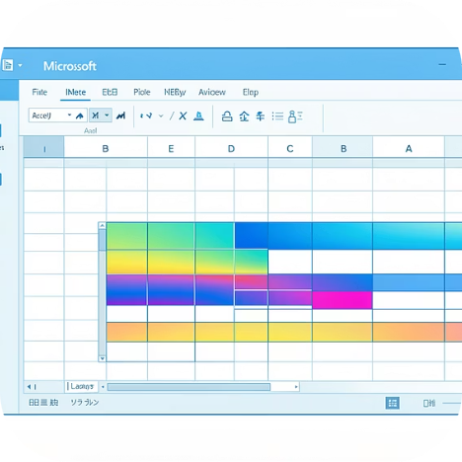
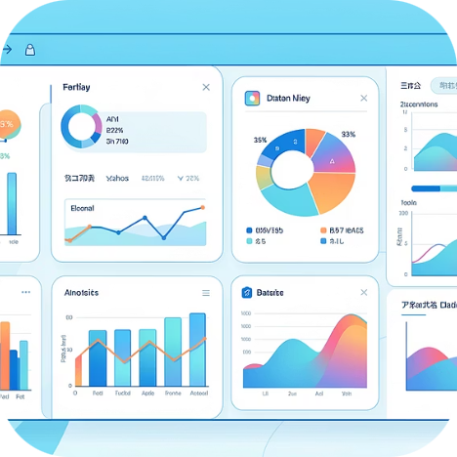
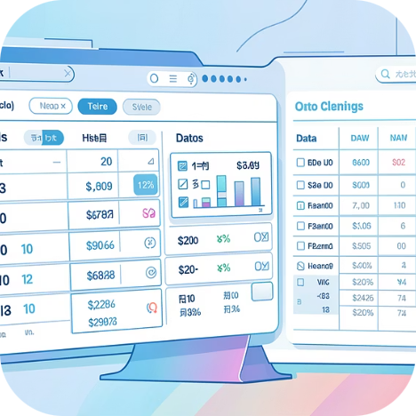
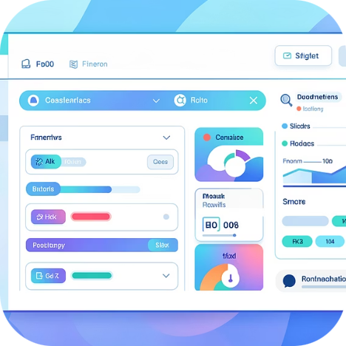
TECHNICAL STACK
Tools & Skills Used
Microsoft Excel
Data Visualization
Data Management
Interactive Features
Primary analysis platform
Charts and KPI reporting
Cleaning and formatting
Slicers and conditional formatting

